Slide 1

Customer Shopping Behavior Analysis
3,900 purchases • 18 columns • transactional insights

Slide 2

Dataset Summary
Size
Key Features
Rows: 3,900 • Columns: 18
Demographics, Purchase details, Behavior metrics
Missing Data
37 values in Review Rating

Slide 3

Exploratory Data Analysis
01
Load & Inspect
pandas: df.info(), .describe()
02
Clean & Impute
Imputed Review Rating by category median
03
Engineer Features
age_group, purchase_frequency_days
04
Standardize
Renamed columns to snake_case

Slide 4

SQL Analysis (PostgreSQL)
Revenue by gender
High-spending discount users
Top products by rating
Shipping type comparison

Slide 5



Discount Users
Female
Male
Many still spend above average
Revenue: 75,191 — discount users
Revenue: 157,890 — higher spenders
Top Rated Items
Gloves, Sandals, Boots, Hat, Skirt
Revenue: Male > Female

Slide 6
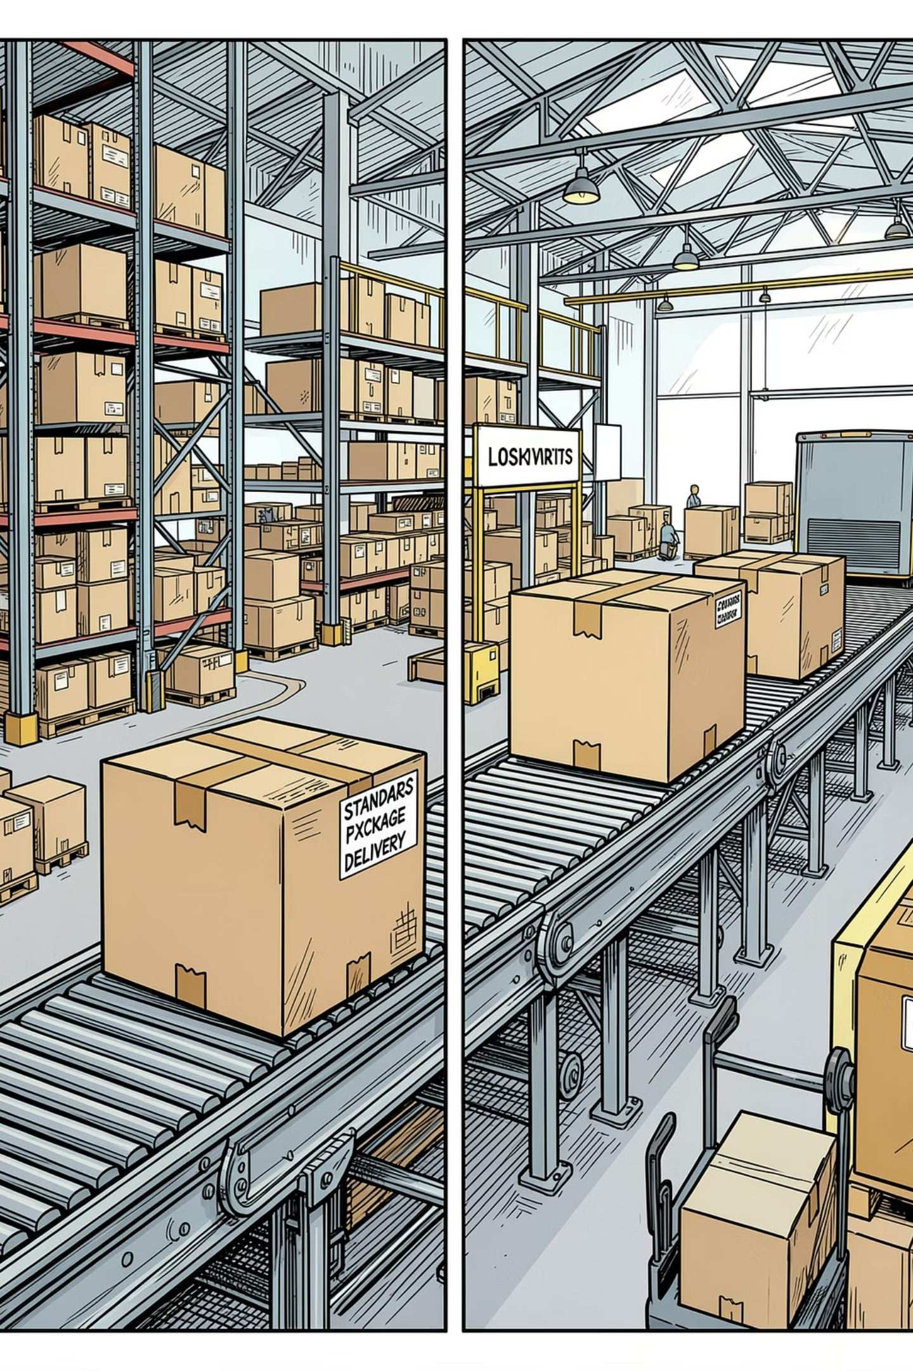

Shipping Type Comparison
Average purchase: Standard $58.46 — Express $60.48
Small difference — consider targeting express users

Slide 7
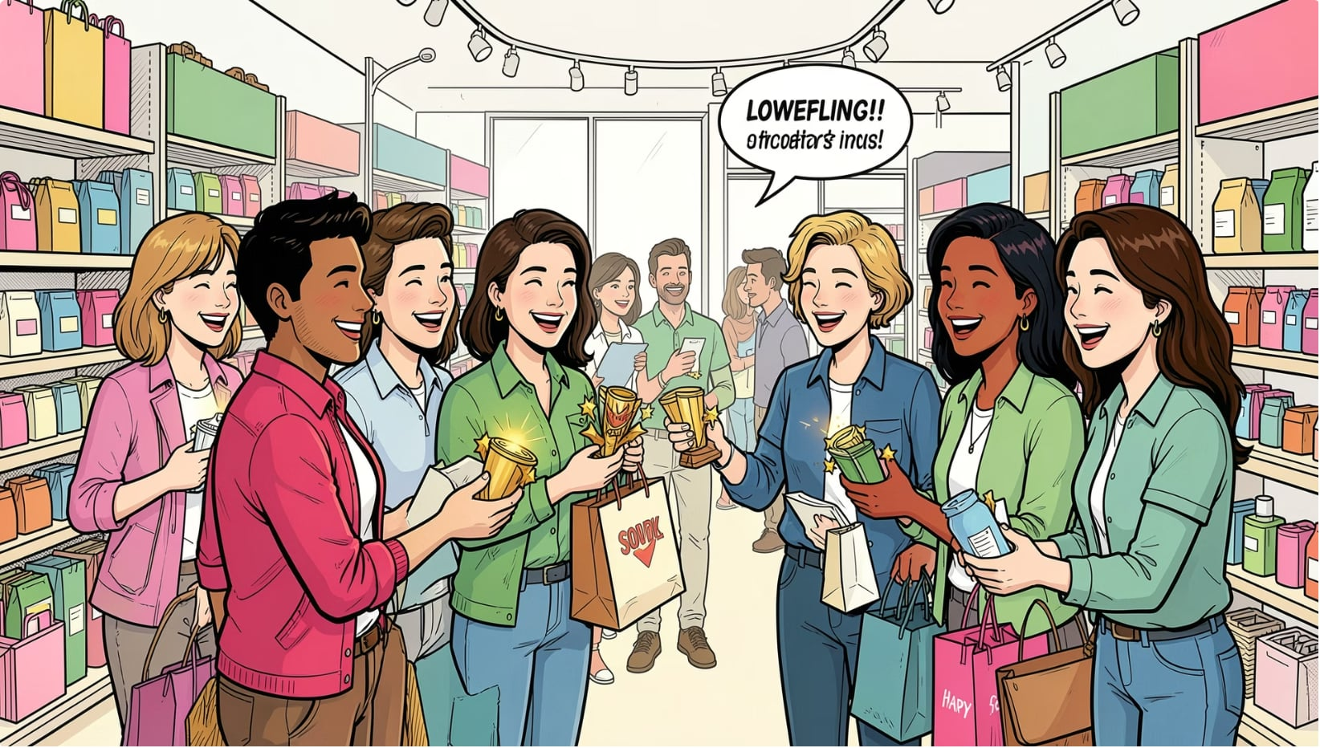
Subscribers & Segments
Subscription
Yes: 1,053 customers • Avg spend $59.49 • Revenue $62,645
Non-subscribers
No: 2,847 customers • Avg spend $59.87 • Revenue $170,436
Customer Segments
Loyal 3,116 • Returning 701 • New 83

Slide 8
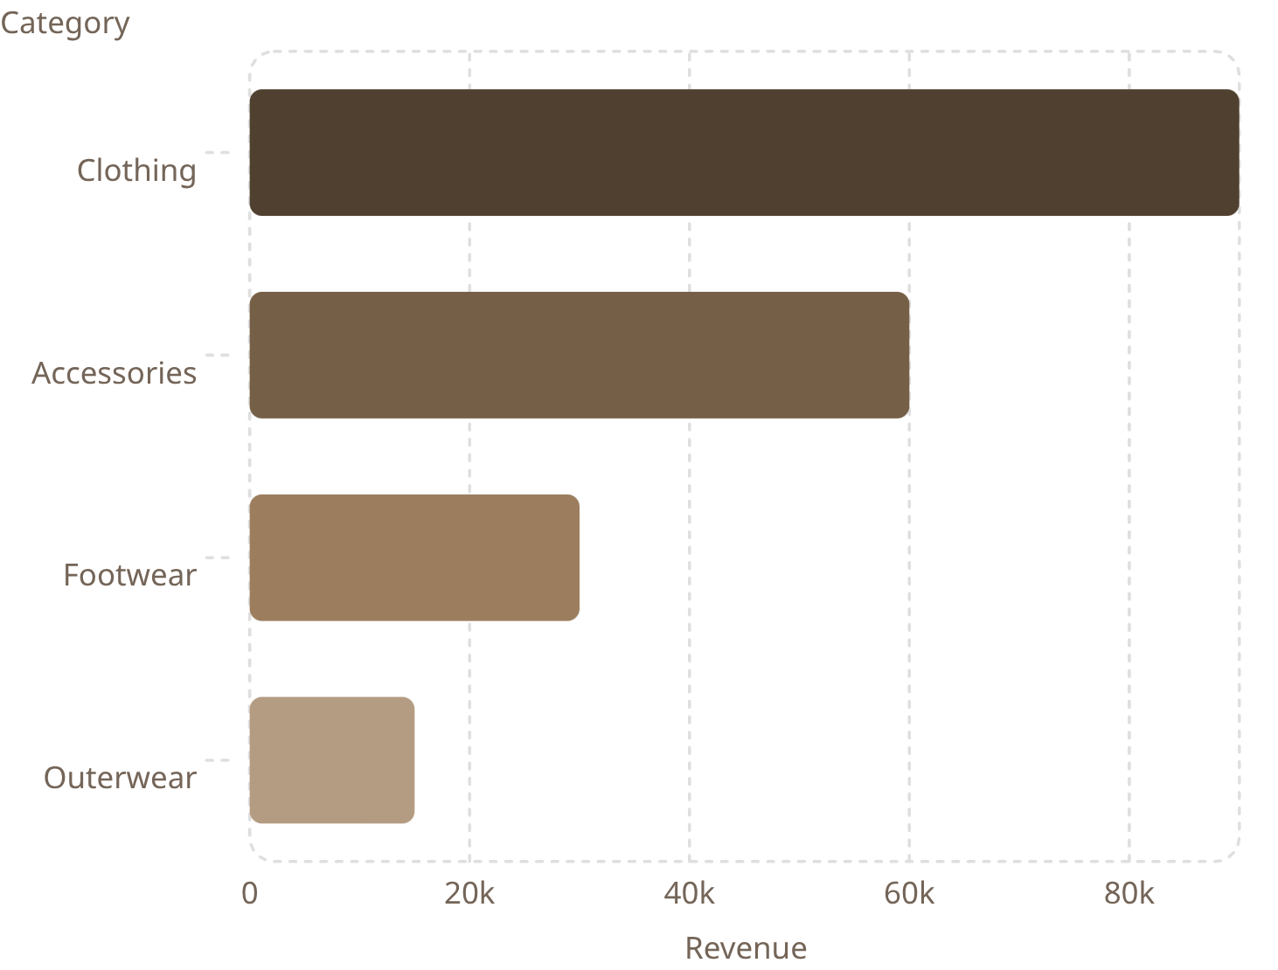



Top Categories
Clothing leads revenue and sales. Highlight top products per category:
Accessories
Clothing
Jewelry, Sunglasses, Belt
Blouse, Pants, Shirt
Footwear
Sandals, Shoes, Sneakers

Slide 9

Revenue by Age Group
Young Adult $62,143 • Middle-aged $59,197 • Adult $55,978 • Senior $55,763
Focus marketing on high-revenue age groups

Slide 10

Business Recommendations
Boost Subscriptions
Loyalty Programs
Review Discounts
Promote exclusive subscriber benefits
Reward repeat buyers to shift to Loyal segment
Balance sales lift with margin control
Product Positioning
Targeted Marketing
Feature top-rated & best-selling items
Focus on high-revenue age groups & express-shipping users
Dashboard built in Power BI for interactive exploration

